Slide 1
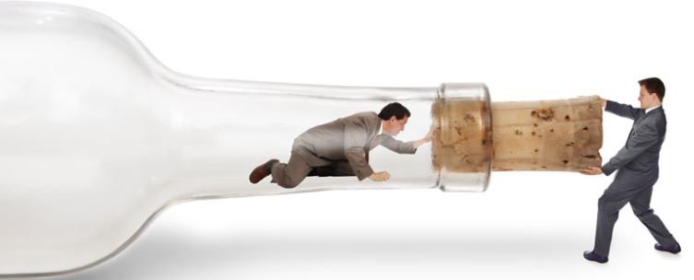
MASTER LEAN – THEORY OF CONSTRAINTS (TOC)
Notes:
Welcome to the MASTER LEAN training FROMM Engineering.
Today we deal with the “Theory of Constraints”
In addition to increasing sales, reducing costs is this the third daily task of the CEO

Slide 2
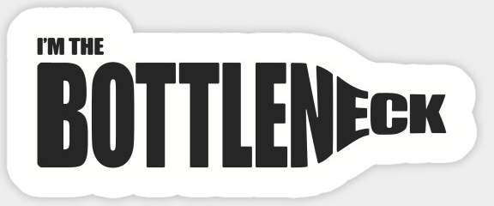

Definition
The Theory of Constraints is an organizational change method that is focused on profit improvement.
The essential concept of TOC is that every organization must have at least one constraint.
A constraint is any factor that limits the organization from getting more of whatever it strives for, which is usually profit.
The Goal of this course is focuses on constraints as bottleneck processes in a job-shop manufacturing organization
In The Goal, Goldratt proves that most organizations have very few true constraints. Since the focus only needs to be on the constraints, implementing TOC can result in substantial improvement without tying up a great deal of resources, with results after three months of effort.
Notes:
Definition
The Theory of Constraints is an organizational change method that is focused on profit improvement.
The essential concept of TOC is that every organization must have at least one constraint.
A constraint is any factor that limits the organization from getting more of whatever it strives for, which is usually profit.
The Goal of this course is focuses on constraints as bottleneck processes in a job-shop manufacturing organization
In The Goal, Goldratt proves that most organizations have very few true constraints. Since the focus only needs to be on the constraints, implementing
TOC can result in substantial improvement without tying up a great deal of resources, with results after three months of effort.

Slide 3
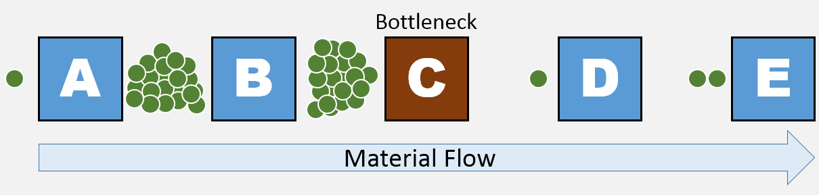
Bottleneck (production)
In production and project management, a bottleneck is one process in a chain of processes, such that its limited capacity reduces the capacity of the whole chain.
The result of having a bottleneck are stalls in production, supply overstock, pressure from customers and low employee morale.
There are both short and long-term bottlenecks.
Short-term bottlenecks are temporary and are not normally a significant problem.
An example of a short-term
bottleneck would be a skilled
employee taking a few days off.
Long-term bottlenecks occur all the time and can cumulatively significantly slow down production.
An example of a long-term bottleneck is
when a machine is not efficient enough and
as a result has a long queue
Notes:
Bottleneck (production)
In production and project management, a bottleneck is one process in a chain of processes, such that its limited capacity reduces the capacity of the whole chain.
The result of having a bottleneck are stalls in production, supply overstock, pressure from customers and low employee morale.
There are both short and long-term bottlenecks.
Short-term bottlenecks are temporary and are not normally a significant problem.
An example of a short-term
bottleneck would be a skilled
employee taking a few days off.
Long-term bottlenecks occur all the time and can cumulatively significantly slow down production.
An example of a long-term bottleneck is
when a machine is not efficient enough and
as a result has a long queue

Slide 4
Identifying bottlenecks
Almost every system has a bottleneck, even if it is a minor one, if every system was running at full capacity, at least one machine would be accumulating processes.
Identifying bottlenecks is critical for improving efficiency in the production line because it allows you to determine the area where accumulation occurs.
The machine or process that accumulates the longest queue is usually a bottleneck, however this isn't always the case. Bottlenecks can be found through: identifying the areas where accumulation occurs, evaluating the throughput, assessing whether each machine is being used at full capacity and finding the machine with the high wait time.
Accumulation
When input comes in faster than the speed of the process, accumulation starts to occur. This means that the machine either does not have enough capacity, is not being fully utilized (inefficient in use) or has an under-qualified operator. This method is not effective at identifying bottlenecks where the queues are at several process steps, as there are multiple processes with accumulation
Full capacity
By using the utilization percentage of each production unit, it is possible to determine the machine which uses the highest percentage of its capacity. This machine is bottlenecking the other machines by 'forcing' them to operate at a lower capacity. However, if all machines in the chain of processes are running at a similar capacity level, increasing the capacity of the lowest machine will not create a significant improvement to the total output.
Throughput
Since the production line is directly linked to the output of the machines, it allows for the identifying of the main bottleneck in the manufacturing process. In changing each machines throughput, it will be possible to assess which machine affects the overall output the most, and hence determine the bottleneck in the chain of processes.
Wait times
In the case where several production units are already running at full capacity, tracking the down time of machines will allow you to identify which machine is being bottlenecked. Usually the machine prior the machine with the highest wait or down time in the chain of processes is a bottleneck. The result of this is a machine being under utilized.[
Notes:
Identifying bottlenecks
Almost every system has a bottleneck, even if it is a minor one, if every system was running at full capacity, at least one machine would be accumulating processes.
Identifying bottlenecks is critical for improving efficiency in the production line because it allows you to determine the area where accumulation occurs.
The machine or process that accumulates the longest queue is usually a bottleneck
To find the bottleneck look on:
Accumulation
Throughput
Full capacity
Wait times

Slide 5
Consequences of bottlenecks in production
The consequences of having bottlenecks in production are possible stalls in production, supply overstock, fall in employee morale and loss of customers.
Bottlenecks can result in the overloading of a machine. Overloading a machine can lead to the machinery getting damaged or worn out and result of this would be potential stretches of downtime in the long term.
Stall in production
A stall in production would be the result of one machine slowing down the entire chain of processes and consistently leaving the other machines unable to continue while it accumulates a large queue. This inefficiency significantly slows down production as many resources such as time, people and machines are being paid to wait.
Fall in employee morale
The result of bottlenecks could require more work from employees as well as longer hours. In addition, there's the factor of stress and frustration with the bottlenecked machine and its operator. This could result in loss of efficiency as employees may not be very motivated to work.
Supply overstock
In the event of accumulation in the long-term, the capacity at which the bottlenecked machine is running could be so slow that the accumulated resources that are in the queue need to be stored. The cost of storing resources is significant as it takes resources to transport the materials back and forth as well as requiring space, another potential cost
Notes:
Consequences of bottlenecks in production
The consequences of having bottlenecks in production are possible stalls in production, supply overstock, fall in employee morale and loss of customers.
Bottlenecks can result in the overloading of a machine. Overloading a machine can lead to the machinery getting damaged or worn out and result of this would be potential stretches of downtime in the long term.

Slide 6
Managing bottlenecks (1)
Once the bottleneck has been identified, assessing the degree of the bottleneck is crucial for determining how to manage the bottleneck.
The bottleneck could be either minor or severe. Minor bottlenecks may not need to be immediately addressed, whereas severe bottlenecks should be dealt with immediately.
There are several ways to eliminate bottlenecks. Some means of doing so are: Adding resources to the bottleneck operation (more people), minimizing downtime, eliminate non-value activities, investing in more machinery which completes the same action and optimizing the bottlenecks operation.
Other sources similarly suggest that once the bottleneck has been identified it is best to ensure it is well maintained, to provide a constant buffer stock upstream of the bottleneck, to reduce time wasted in set ups and changeovers and to train more operators for the bottlenecked machines. These are further explained below.
Having production scheduling to optimize efficiency is another means of effectively utilizing the bottlenecked machine. This minimizes the possibility for the situation where the production quota is not met. Scheduling also reduces the number of situations where production is halted due to a lack of personnel, due to increased organization and greater planned out production. It also allows for the full advantage of the time available to be taken as pockets of time can be found to keep the machine running for as many hours as possible in a week.
Notes:
Managing bottlenecks
Once the bottleneck has been identified, assessing the degree of the bottleneck is crucial for determining how to manage the bottleneck
There are several ways to eliminate bottlenecks. Some means of doing so are: Adding resources to the bottleneck operation (more people),
minimizing downtime, eliminate non-value activities, investing in more machinery which completes the same action and optimizing the bottlenecks operation

Slide 7
Managing bottlenecks (2)
Increasing number of operators or employees
Increasing the number of operators or increasing the number of staff can be beneficial for multiple reasons. Increasing the number of operators can increase efficiency as they can all work different timed shifts and hence the bottlenecked machine can run for longer hours.
In addition, if one worker is sick, unable to work or quits, there will always be someone available to replace him
Eliminating non-value activities
In removing all non-value activities, you reduce the amount of redundant tasks performed by the bottlenecked machine and hence maximize efficiency. Removing the waste operations results in a shorter cycle time hence allowing the machine to complete each process in less time
Provide a constant buffer stock upstream
In order to optimize the usage of the machine, the machine should be kept running for as long as possible and hence should never have to wait for materials or stock to increase productivity.
This can be achieved by putting a buffer stock in place so that the machine always has some task it can be doing. The down side to that inventory space will be needed to store the buffer for when the machine before it in the chain of processes is working
Minimizing downtime, setup and changeover time
To compensate for being the weakest link in the chain of processes, the bottleneck machine will have to run for longer periods of time.
Changeover and setup time should be minimized to allow the machines to run for slightly longer, reducing the impact of the bottleneck. Minimizing downtime by having the bottlenecked machines run from earlier until later is a common strategy for working around the problem, however this does increase the likelihood for the machine to be overloaded and need regular maintenance.
Notes:
Managing bottlenecks
You can find in the presentation the details to Manage Bottlenecks
Increasing number of operators or employees
Minimizing downtime, setup and changeover time
Eliminating non-value activities
Provide a constant buffer stock upstream

Slide 8
Preventing bottlenecks
Preventing bottlenecks would be ideal to avoid having to manage and resolve them in the future.
There are ways to work around them when planning the production environment.
Giving employees free rein over minor decision making will allow them to make the decision they feel is most efficient, and being operators of the machine, their experience will allow them to become specialized in the use of the machine over time.
Cross-training employees will increase adaptability in the production line and hence reduce potential downtime in the future. Hiring high performance employees will reduce the possibility for bottlenecks to be formed by underperforming employees who are inefficient at using their assigned machinery.
Planning for a higher potential output when designing the production environment is crucial in the long run for occurrences of larger orders when there is need to run all the machinery.
Having all the machinery running at full capacity is not always ideal due to situations where malfunctions occur and production is halted. Having inspiring leaders who having a strong understanding in how to keep production smooth will allow greater control of all the different processes in the chain of production. Taking into account the layout of the different processes can also increase efficiency as it minimizes delay caused in the transportation stage. The use of a proper layout can reduce the overhead of machines and can reduce material handling time.
Establishment of standardized exchanged protocols can minimize the potential for future bottlenecks to occur through minimizing down time. This increases efficiency by reducing any potential confusion between different sectors and hence reduces the possibility for delays of the arrival of raw materials.
Notes:
What should you do “Preventing bottlenecks”
Plan the production environment
Give employees free rein
Prepare Cross-training employees
Plan for a higher potential output
Establish of standardized exchanged protocols (SMED)

Slide 9
Thank you for your attention!
Further information can be found on the FROMM Engineering website.
If you have further questions, send me an email to carlo.fromm@cfromm.com
Notes:
Thank you for your attention.
Further information can be found on the FROMM Engineering website.
If you have any questions, please send me an EMAIL or contact me via my YouTube channel.
You will receive a response within 48 hours.
Good luck to eliminate the bottleneck

