Slide 1
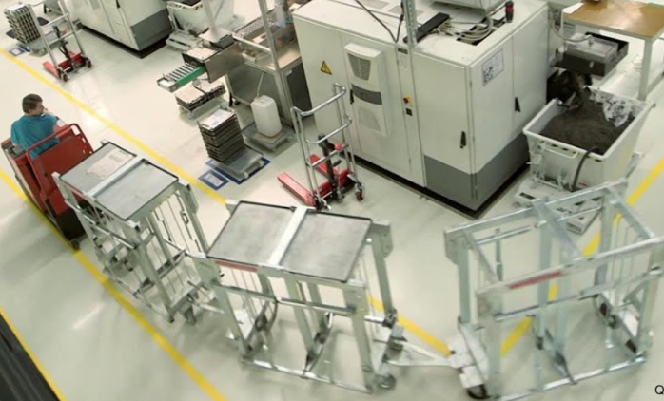
Milkrun process
1- The model of the milk run principle was the traditional milk boy in America and England, who only provided a milk bottle if he could take an empty bottle with him. This ensured that there was never too much milk in the house and that it could go bad.
2- The concept is based on the basic idea that only the material is replenished in the amount as it was used up. The lot size is set once (a milk bottle) and, if necessary, controlled by signal cards (Kanban). The replacement cycle and the route are also set in advance (similar to a bus schedule).
3- This method allows reduced inventories, optimization of production time, reduction of waiting time, use of less handling equipment, reduction of factory traffic, leveling of material receiving flow and scheduled shipments.
Benefits
1- Reduction of works traffic
2- Leveling the daily material flow.
3- Reduction of lots.
4- Reduction of costs in connection with material transport.
5- Significant reduction in parts loss throughout the process.
6- Instructs the parts to follow the sequence of operations specified in the manufacturing order.
7- There is not necessarily a financial effort required, with organization and standardization it will be a good one
Result achieved.
FROMM Engineering
Milkrun
5
6
1

Slide 2
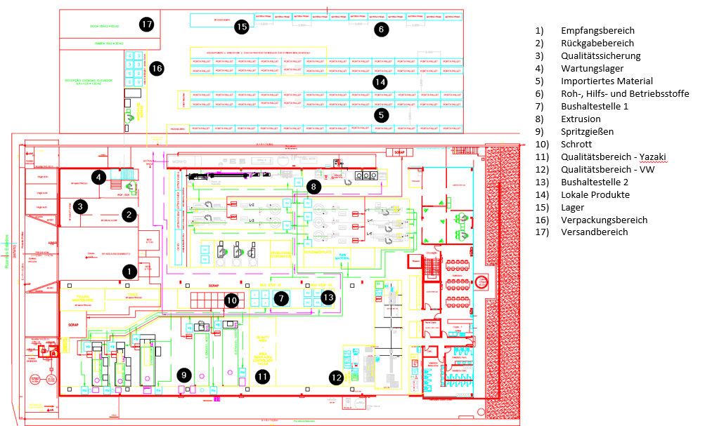
Receiving Area
Returns Area
Quality room
Maintenance warehouse
Imported Stock Area
Raw Material
Bus Stop 1
Extrusion
Injection Molding
Scrap
Quality Area - Yazaki
Quality Area - VW
Bus Stop 2
National Product
Warehouse
Packing area
Shipping Area

